Slide 1
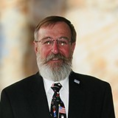
Welcome to 2021 Pennsylvania Kiwanis District Midyear Conference Opening Session
Midyear 2021 Virtual Conference
February 20, 2021
Governor Don Smith

Slide 2
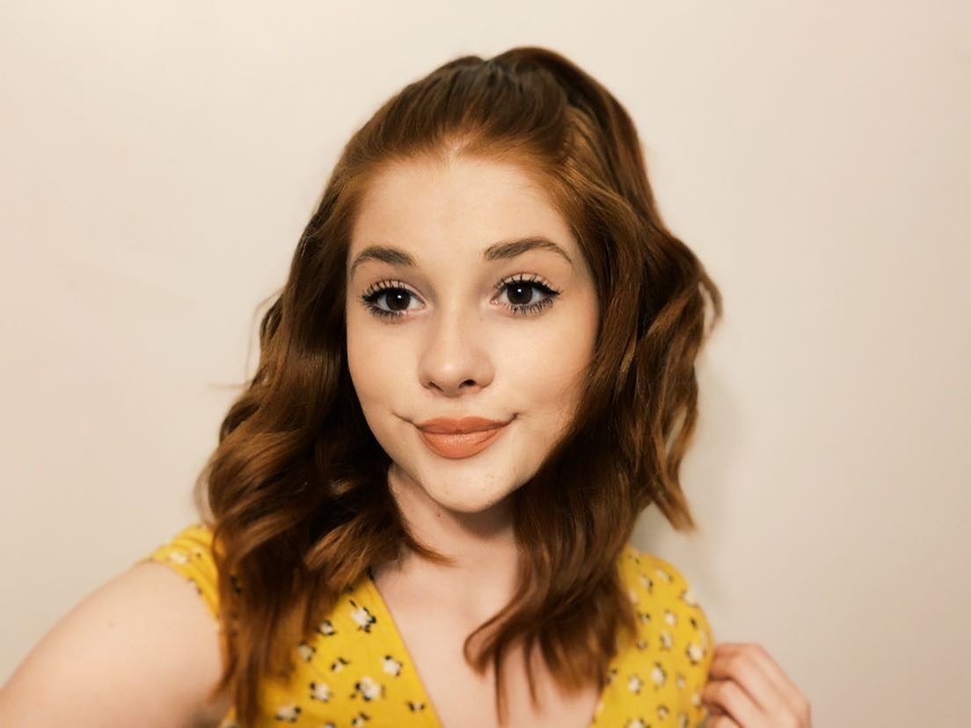
Pennsylvania Key Club Governor Remarks
Ashley Wheeland,
Montoursville High School Key Club

Slide 3
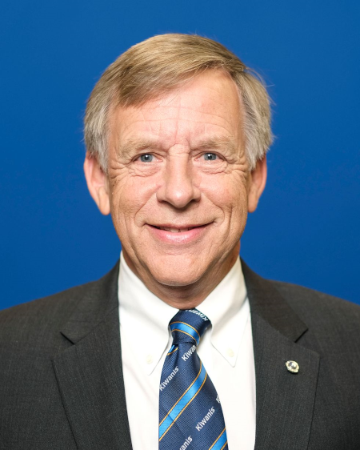
Kiwanis International Trustee Remarks
David Hurrelbrink,
Kiwanis International Trustee

Slide 4
https://youtu.be/EHuyTNh34co

Slide 5
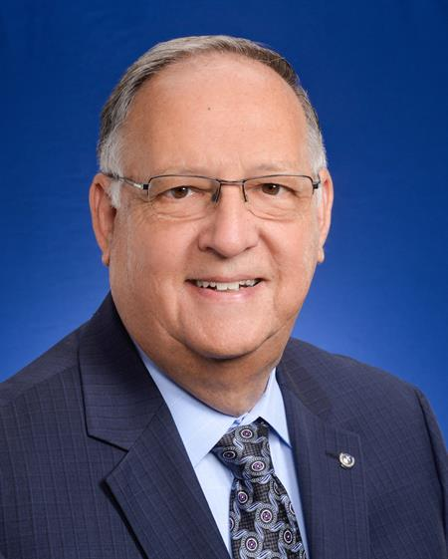
Kiwanis International President Remarks
Art Riley,
Kiwanis International President

Slide 6
https://vimeo.com/503648519/99696e01f
Notes:
Fall back: https://vimeo.com/503648519/99696e01fb go directly there.

Slide 7
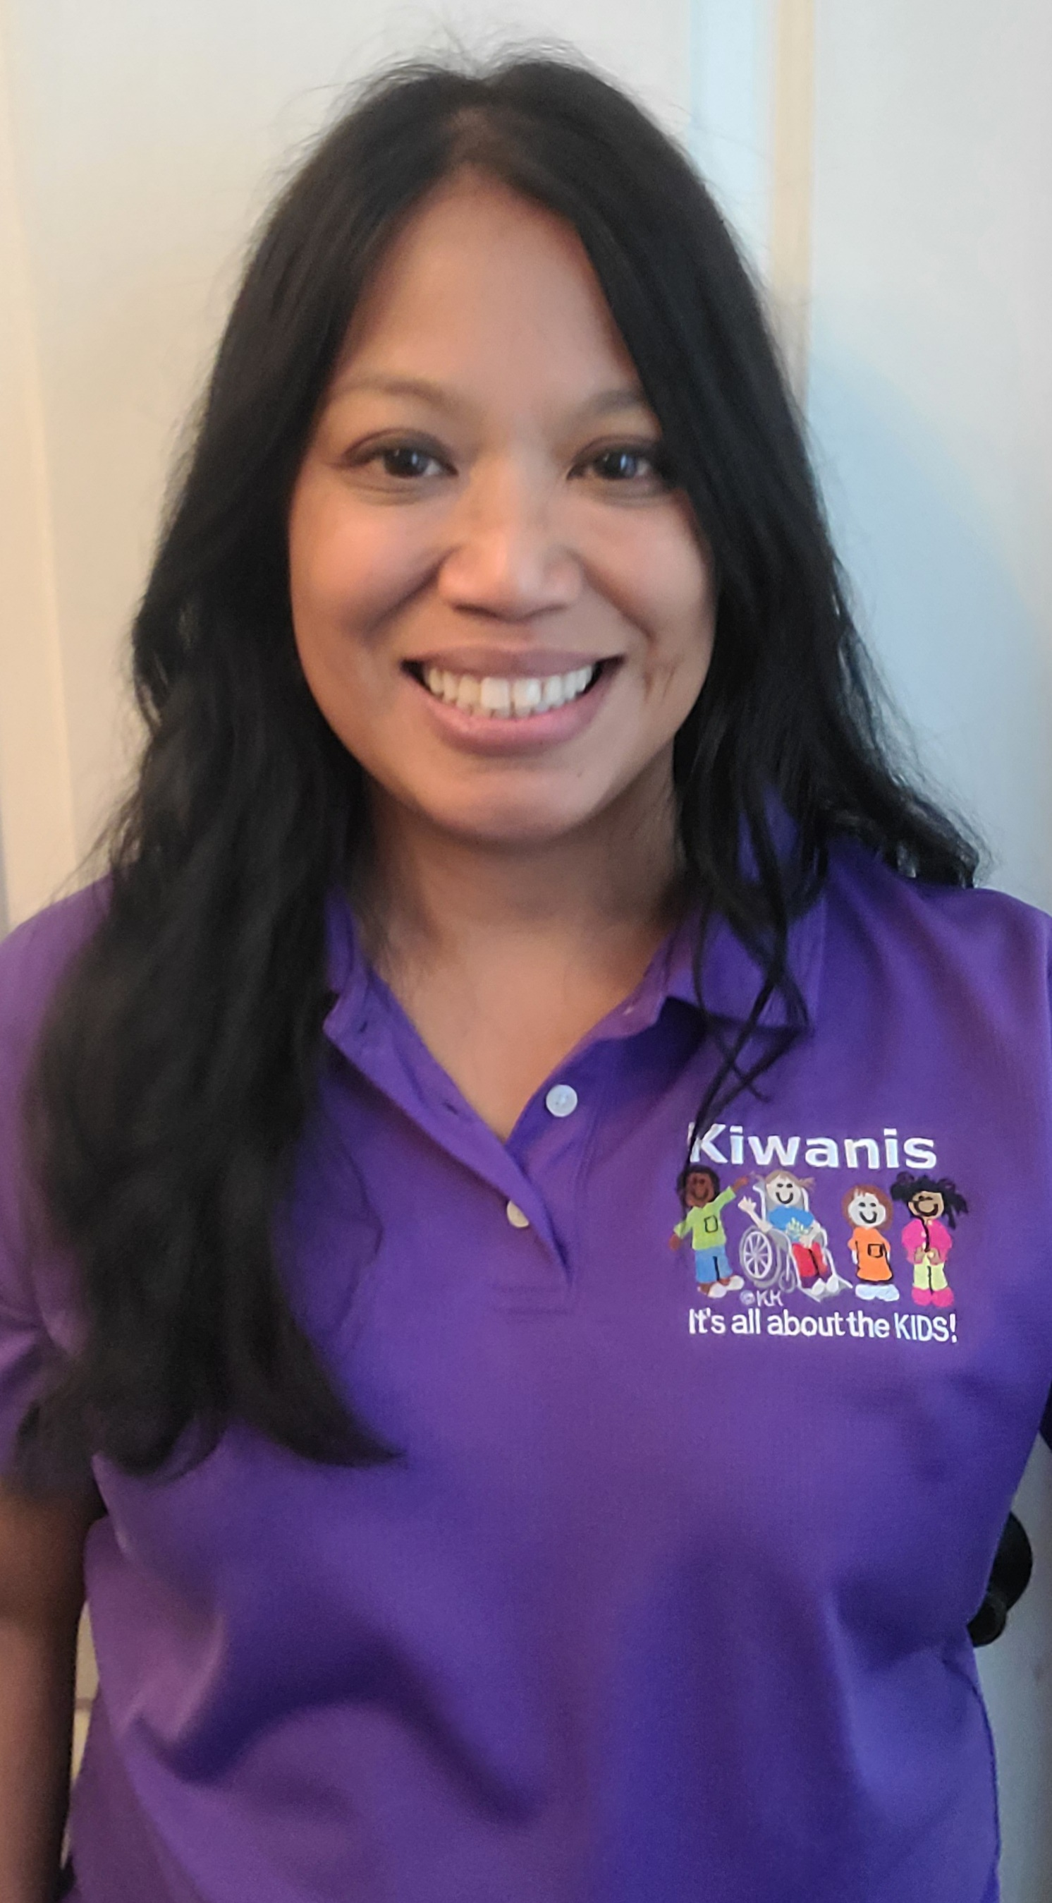
Pennsylvania District Governor Elect
Sarah Zulueta,
Kiwanis Clubs of University City and the Main Line

Slide 8
Midyear Conference Logistics
3 Rounds of Forums (35 minutes each)
Main Zoom Room -https://bit.ly/Midyear_MainRoom
Zoom Room 2 - https://bit.ly/Midyear_Room2
Zoom Room 3 - https://bit.ly/Midyear_Room3
1 Group Forum – Covid 19 Risk Management
Main Room https://bit.ly/Midyear_MainRoom
Break Out Rooms and Closing Session – Main Room https://bit.ly/Midyear_MainRoom
Notes:
Main Zoom Room - https://bit.ly/Midyear_MainRoom
Zoom Room 2 - https://bit.ly/Midyear_Room2
Zoom Room 3 - https://bit.ly/Midyear_Room3

Slide 9
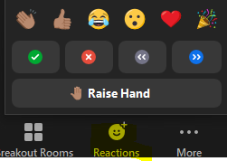
In Forums
All Sessions will be recorded
Chat will be open to send questions or comments to Host(s) only
Members will be muted during presentations.
Please use Raise Hand function to ask question.

Slide 10
Breakout Rooms
Available only in the Main Zoom Room
Click on your BREAKOUT Room icon on Zoom control bar
Opens during breaks and after group forum at 12:25 pm
Must have Zoom Client 5.5 or higher to participate!
Notes:
https://support.zoom.us/hc/en-us/articles/360042414611-New-Updates-for-Zoom-Clie?fbclid=IwAR3pJPy99UjwK4ZPhxLbQuL0IVESMBQZYK4iro9JiS5YwNtMrpvJvgiAuuw

Slide 11
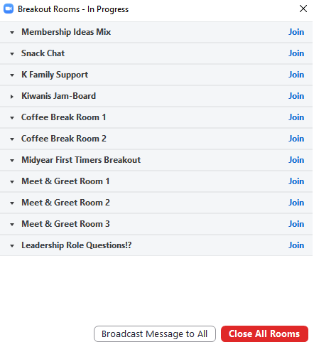

Slide 12
Enjoy your Midyear Experience
Message HOSTS via Zoom Chat for any questions and issues during the Midyear Virtual Conference:
Sarah Zulueta – Main Room
Bob Orlando / Shawn Smith – Room 2
Tiffany Callaio – Room 3

Slide 13
Forum Round 1 Starts at 9:50 am
To Join: Getting Your Club Mojo Back: Motivate and Value Members with Emily Sharp STAY RIGHT HERE!
To Join: Making Virtual Meetings Fun and Engaging with Chris Martz Goto Room 2: https://bit.ly/Midyear_Room2

