Slide 1
Get your club mojo back: motivate & value members
Emily Sharp
Kiwanis International Area Director
Notes:
Hi everyone! My name is Emily Sharp and I am an area director on staff here at Kiwanis International. Today we are going to talk about motivation and specifically how to find, harvest and share that motivation with the members you work with on a daily basis. So let’s get started!

Slide 2
Motivation – know, find, share
The reason or reasons one has for acting or behaving in a particular way
The general desire or willingness of someone to do something
Notes:
First of all, before we can talk about how to get motivation, we need to define what we are actually talking about. The definition of motivation is the reason or reasons one has for acting or behaving in a particular way or the general desire or willingness of someone to do something. There are also many different types of motivation such as intrinsic and extrinsic motivation. Let’s take exercising as an example. I try to exercise 3-4 times a week for multiple reasons, such as I my passion for walking, I think classes are fun, and the overall purpose of my health which would all be intrinsic motivations. I also try to exercise 3-4 times a week because I am getting married in October and want to love the way I look in my wedding dress – this is an extrinsic type of motivation!

Slide 3
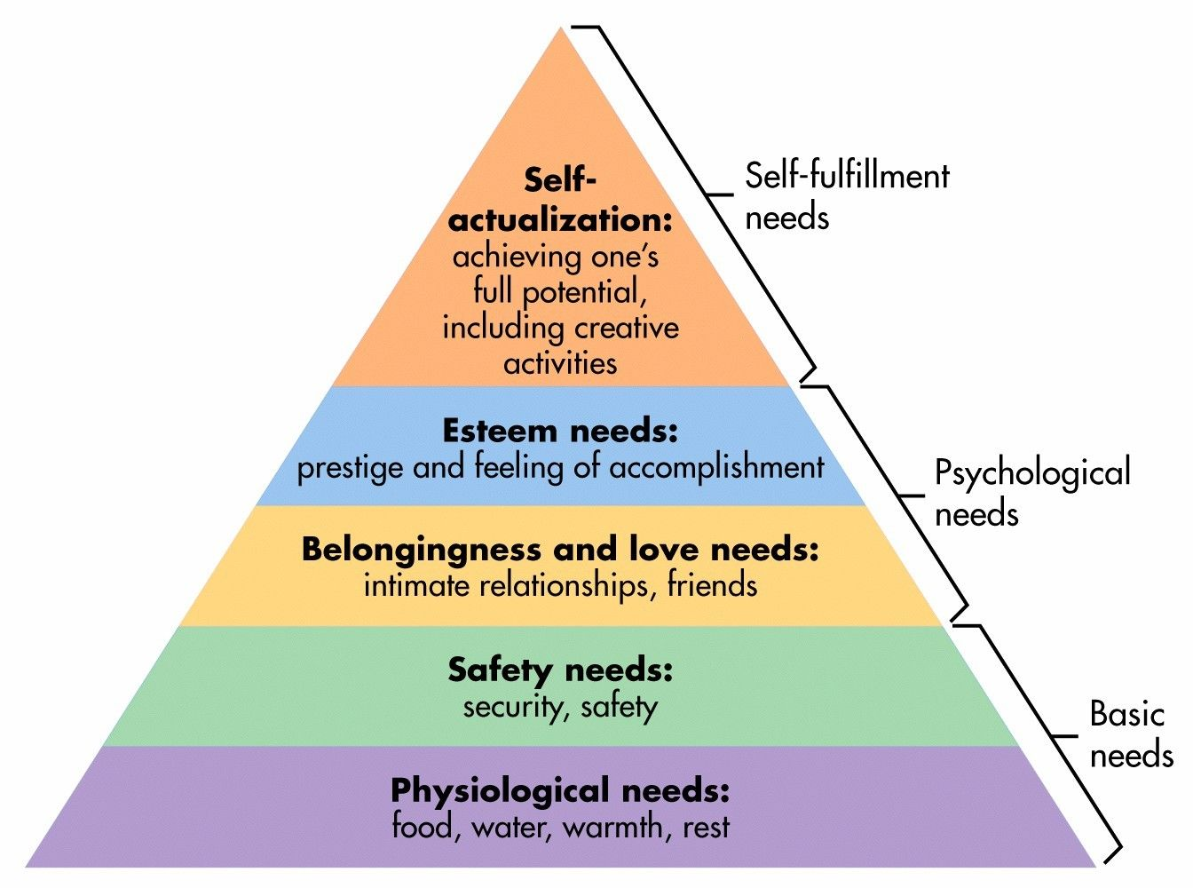
Maslow’s Hierarchy of Needs
Notes:
There is a little bit of science that comes with motivation that we need to talk about. As humans, some of our motives are biological and some have personal and social origins. For example, we have probably all heard of Maslow’s hierarchy of needs, right? Our basic needs come first - we don’t need a lot of motivation to want food, water and rest followed by the desire to need safety and security. That is our human nature. After that, you can see we have needs of wanting relationships, feeling accomplishment and then self fulfillment. Our motivations change to want those things more in life because again as humans, we don’t want the same things over and over again – we crave change.

Slide 4
Motivational Marketing
Marketing Mindset by Will Leach
Achievement
Belonging
Competence
Engagement
Security
Esteem
Notes:
Along with the science, comes study after study of what companies have done about us as consumers to try and buy their products. A few months ago, I was reading a really interesting article from a book called Marketing to Mindstates by Will Leach. The article talks about the fact that if a company can figure out what motivates their consumers, you can market your brand to them on a deeper level. Here are a few of those types of motivations that stuck out to me:
Achievement – a good example of achievement would be Nike with their famous slogan, Just Do It. Nike makes you think that whatever it is you want to achieve, we can do it together. Simple, powerful and makes you have that “we can help you get there” experience.
Belonging – Harley- Davidson does a good job evoking the idea that when you have a Harley, you belong and you are part of a tight knit family. Same thing with CrossFit and professional or college sports team. As a fan, you cheer on the same team and have a common bond and that tribe feeling.
Competence – when you think about competence, you think about being capable, qualified, prepared and skilled. Home Depot comes to mind with all of those home improvement projects we have been doing lately during quarantine. Consumers walk into Home Depot looking for the motivation for tools and resources to feel more capable and ready when its time to begin that project.
Engagement – Disney world is the best example of engagement because you are literally engaged from the beginning when you are purchasing your tickets. With every turn you take, you are enjoying their magical experience. Nostalgia plays into this too.
Esteem – Think about luxury brands such as Lexus, BMW, Chanel or even social media. When we get that “like” on something we post on social media, it instantly gives us that feel good feeling when others like it.
Security – think home security brands such as ADT that make your home feel safe from outside threats. Your motivation to keep your family safe and secure put companies like these at the top of your mind.

Slide 5
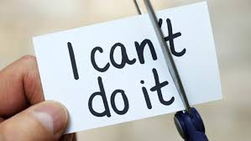
Why is motivation important?
Notes:
Now why am I sharing all of this with you? When it comes to different types of motivation, I believe you can use these same tactics to motivate the members in your clubs to achieve the mission of Kiwanis. Now for a quick reminder about what that mission or motivation of our organization is: to serve the children of the world, one child and one community at a time. In my opinion, there is no other mission statement better than that! So my question for you is simple: what was your motivation for joining Kiwanis? Why are you here today? Why are you a leader or a future leader? Why do you care about helping children and making a difference in your community?

Slide 6
What is your motivation?
Contribution
Learn new skill
Ownership of situation
Desire for change
Fun
Meet new people
Personally asked
Organization participation
Enjoy the work
Other
Notes:
Over the past few years, I have asked the people I work with what their motivation is to volunteer with Kiwanis. I’ve kept all of the answers in a little notebook and I want to share some of them with you today. Some of the reasons I have heard are:
They want to contribute to a cause in which they believe in
They want to learn new skills
They want to have a sense of ownership and control over something they can help fix
They have a desire for change
They want to have fun
They want to meet new people
They were personally asked
An organization with which they are affiliated with is participating
They enjoy the type of work that is being done
Most of these answers are motivations that are tied to emotions. They go back to many of our human needs such as the desire to have relationships, achievements, etc. So how do we take these emotions and harvest them to help accomplish the goal of our organization? Well I’m glad you asked!

Slide 7
Ways to motivate volunteers
Know their reasons for volunteering
Communicate
Value people’s time
Play to their strengths
Show your appreciation
Notes:
Know their reasons for volunteering and talk about it. There are things that naturally motivate us. Find out those reasons and keep them at the forefront of conversations
The easiest way of keeping up your members motivations are through communications. This helps manage expectations and responsibilities of your work. It’s also a good idea to welcome suggestions and feedback. Show people that they opinion matters and you’ll get people who are willing to do their best work.
Value people’s time. People volunteer because they want to make a difference in the world. They have busy lives and competing responsibilities like we all do so if they don’t feel like they are making a difference, they won’t want to continue to share they time and energy. We can only master something we care about – we shut down if we think we are better off doing something else.
Play to their strengths. The ones they self identified, not what you have identified for them. Utilize their skill set and respect their uniqueness.
Show your appreciation. Thank them and then thank them again! Share how you are making a difference through social recognition.
Record a video message about why volunteers are valuable then play that video during a meeting!
Send handwritten notes

Slide 8
Discussion
What motivated you to join Kiwanis?
What has motivated you to stay in Kiwanis?
Has that motivation changed?
How do you motivate the members in your club?

Slide 9
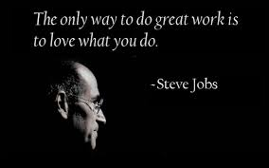
Thank you!
Emily Sharp
Esharp@kiwanis.org
Notes:
I know we are almost out of time so thank you so much for spending time with me this morning. I know you had a choice of participating today and which workshops you wanted to go to so I’m really glad you chose this one. I hope you have learned a little bit about motivation and maybe even a little motivation to take back with you to your club members too!
Let me know if you need anything!

